Slide 1

The Quest for Zero Fatalities: Utilizing Machine Learning ​ To Discover Key Factors To Reduce ​ Singapore Traffic Accidents​
Chong Wei Kang U2121461B ​
Loy Sheng U2010347G ​
Ng Shang Yau​ U2121960G
Nguyen Thi Thanh Mai U2010484A ​
Toh Yi Cheng​ U2010698A
​
Notes:
Good morning prof, we are group 5 and today we are sharing on our project, the quest for zero fatalities and utilizing machine learning to discover key factors to reduce traffic accidents in Singapore.

Slide 2
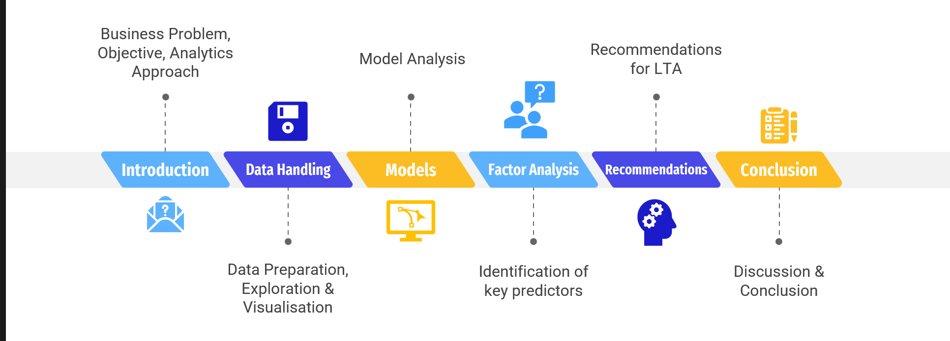
Table Of Contents
Wei Kang
Notes:
We will first start by giving a brief introduction, followed by introducing our data handling process, followed by our models and factor analysis, before ending off with some recommendations for LTA and our conclusion.

Slide 3
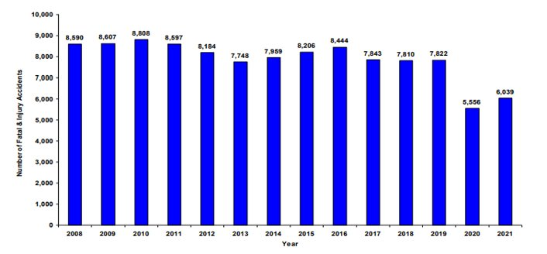

Business Problem
Wei Kang
Road Accident Statistics
High prevalence of traffic accidents over the years despite current measures
Decrease Misleading due to Covid-19 lockdown period
Notes:
So we will first start off by sharing our business problem at hand. There's a high prevalence of traffic accidents over the years despite current measures. If you take a look at the bar graph on the right, you might be misled to think that the traffic accidents may be reducing in the recent years. However, this decrease was most likely due to the COVID situation and lock down in 2020, where singaporeans were forced to stay at home, which resulted in a much lower amount of cars on the roads and a much lower probability of traffic accidents. In 2021, we see a surge in traffic accidents again which is of great concern.

Slide 4
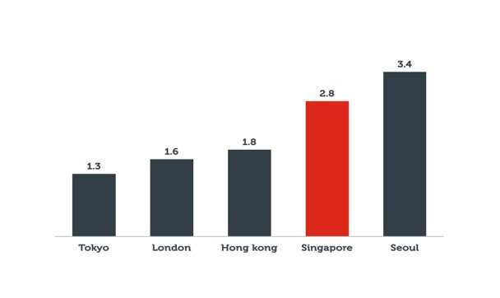
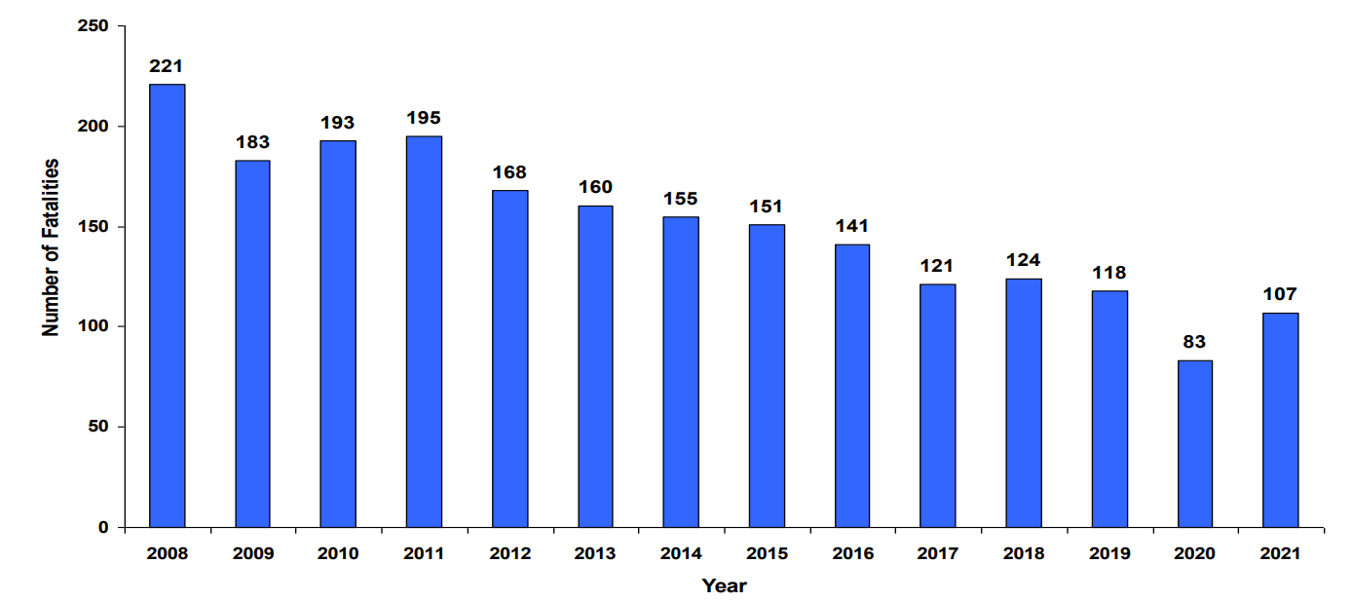
Business Problem
Wei Kang
Road Accident Statistics
Number of fatalities
Number of fatalities per vehicle
Notes:
However, the good thing is that the number of fatalities has been decreasing year on year, ignoring the abnormaly of 2020. This is a good sign but, if we were to compare the number of fatalities per vehicle, we still fare worse compared to countries such as Japan, the UK and Hong Kong. This also means that while Singapore may see fewer road accidents compared to its counterparts, the accidents are more severe.

Slide 5
Business Problem
Wei Kang
Key Problem
S$ 610.3 million
in costs annually
Notes:
So what does this mean for the LTA and the Singapore government? Costs. The costs are high for traffic accidents, especially so for more serious accidents. In fact, it was estimated that traffic accidents cost about 610.3 million annually. This was already a very conservative estimate in 2006 and the actual amount today may be way higher than this amount. This large amount of money could easily have been saved and used for better purposes in our economy and betterment of society if we managed to achieve zero fatalities on our roads.

Slide 6
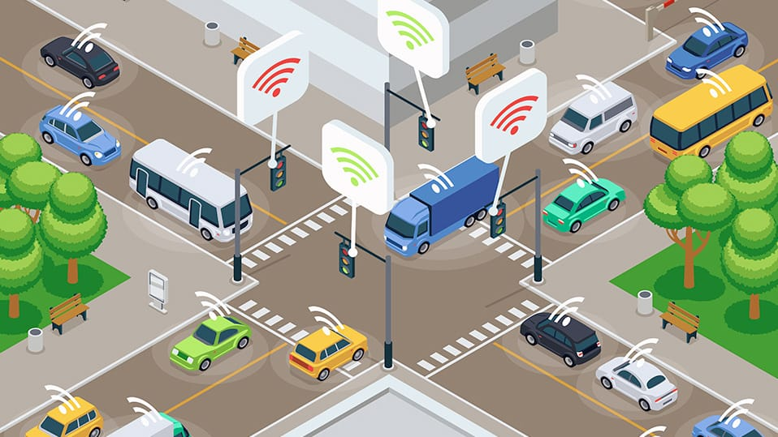
Business Problem
Wei Kang
Current Measures
Network of sensors & cameras that collect data on traffic flow and road demand
Optimize transportation networks
Provide real-time information about road conditions
Identify accidents in real-time and automatically adjust traffic signals
Intelligent Transport System
Notes:
We will take a closer look at what the LTA and the Traffic Police has already implemented to tackle the current problem. Firstly, the Intelligent Transport System is a network of sensors and cameras that work 24/7 to collect data on traffic flow and road demand to optimize transportation networks and boost safety in Singapore. Drivers can access real-time information about road conditions, enabling them to make better travel plans and avoid congested areas which are more accident-prone. Additionally, the system is also able to identify accidents in real-time and automatically adjust traffic signals, alert emergency services or redirect traffic flow.

Slide 7
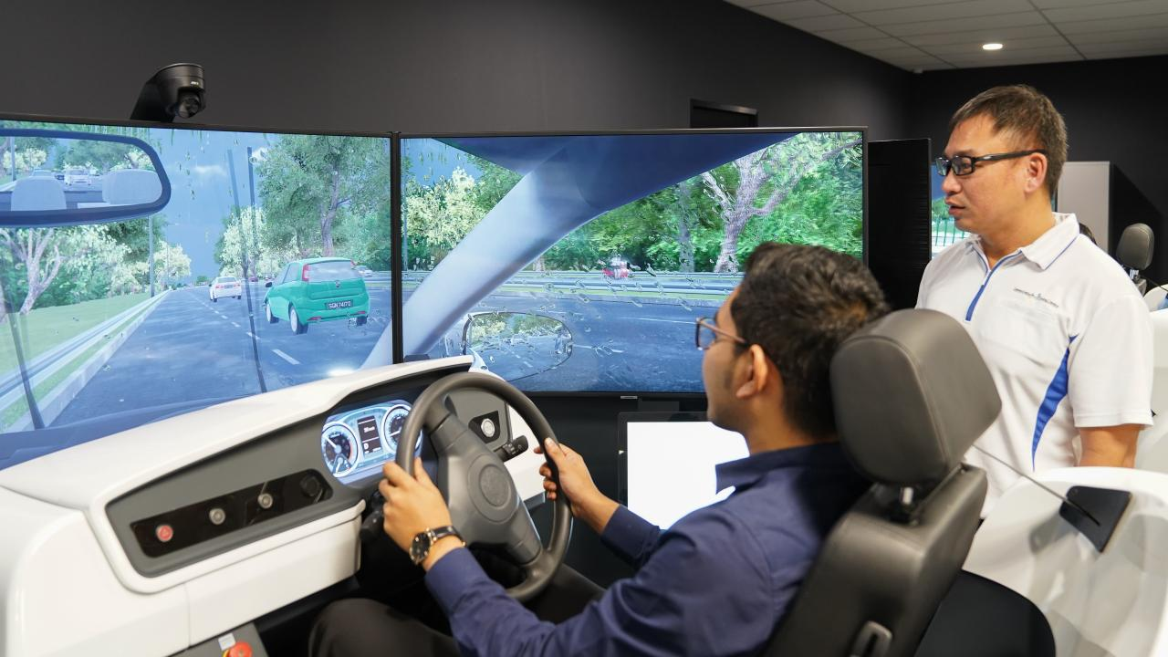
Business Problem
Wei Kang
Current Measures
Compulsory simulation training for all learner motorists
Training scenarios based on top 10 causes of traffic accidents
Practice in safe and controlled environment
Teach safe practices to new drivers
Simulation Training
Notes:
Secondly, in 2019, the Singapore Traffic police has also made simulation training compulsory for all new motorists and training scenarios were based on the top 10 causes of traffic accidents that frequently cause injuries. Through simulation training, the new learner drivers can practice defensive driving in a safe and controlled environment, and prepares them for a variety of road circumstances.

Slide 8


Business Problem
Wei Kang
Underlying Issue
Multi-faceted Problem
Human Error
Vehicle Malfunction
Road Design
Weather Conditions
Jaywalking
Heinrich Domino Theory
Notes:
So, the current solutions sounds pretty good right on first glance? Why are traffic accidents still so prevalent then? Well, the underlying issue is because traffic accidents are a multi-faceted problem with many possible root causes, making it difficult to address effectively. For example, all of these factors can contribute to accidents. Human error, vehicle malfunction, road design, weather conditions, jaywalking are all possible causes. A combination of these factors are also possible. According to the Heinrich Domino Theory, even a small error can

Slide 9



Objectives
Wei Kang
Business Objectives
Reduce traffic accidents in Singapore
Increased Cost Savings
Efficient Resource Allocation

Slide 10


Analytics Approach
Wei Kang
Key Business Questions
Question 1
What are the factors that contribute to the occurrence of fatal accidents?
Question 2
What are the most significant factors to predict the accident outcome whether one dies in a road accident?

Slide 11
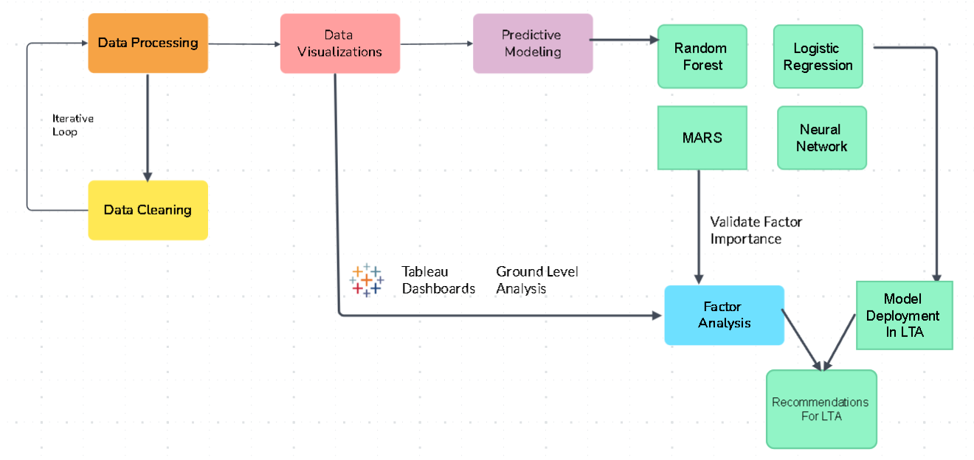
Data Pipeline
Wei Kang
Overall Pipeline

Slide 12
Evaluation of Analytics Outcome
Wei Kang
Key Performance Indicators |  | Performance measurements
1 | Reduction of road fatality rate per 100,000 citizens by 10% within 5 years |  | Record and compare the annual number of deaths related to road accidents per year after implementing the analytics solution to the baseline figure prior to implementation
2 | Increase the survival rate of road accident victims by 15% within 5 years |  | Record and compare the number of people who died in a crash, en route to medical and those who survived per year after implementation of the analytics solution.
3 | Decrease costs associated with road accident fatalities by 20% within 5 years |  | Record the estimated economic costs due to loss of workers, welfare costs, insurance payouts, healthcare and other costs attributable to road accidents per year after implementation of the analytics solution.
Notes:
First point is in line with the industry standard of WHO

Slide 13
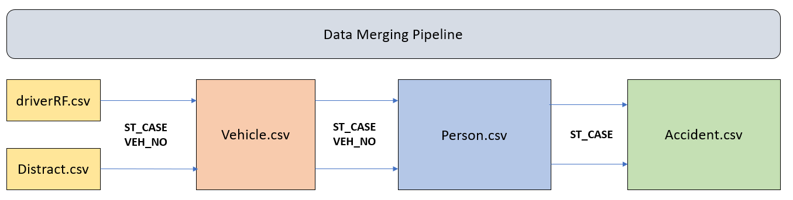
Data Pre-processing
Wei Kang
Processing Steps

Slide 14
Data Pre-processing
Wei Kang
Injury Severity
Death
No Apparent Injury
Possible Injury
Suspected Minor Injury
Suspected Serious Injury
Injured, Severity Unknown
Unknown/ Not Reported
No
Fatal Injury
Died Prior To Crash
Yes

Slide 15
Data Exploration
Mai
Question 1
What are the factors that contribute to the occurrence of fatal accidents?
Human
Road & Environment

Slide 16
Data Exploration
Mai
Question 1
What are the factors that contribute to the occurrence of fatal accidents?
Human
Demographic
Road & Environment
Vehicle
Road Safety manner
Driver
Speed

Slide 17
Data Exploration
Mai
Question 1
What are the factors that contribute to the occurrence of fatal accidents?
Human
Demographic
Road & Environment
Location
Vehicle
Time
Road Safety manner
Traffic flow
Driver
Speed

Slide 18
Data Exploration
Mai
Question 1
What are the factors that contribute to the occurrence of fatal accidents?
Human
Demographic
Road & Environment
Location
Vehicle
Time
Road Safety manner
Traffic flow
Driver
Speed

Slide 19
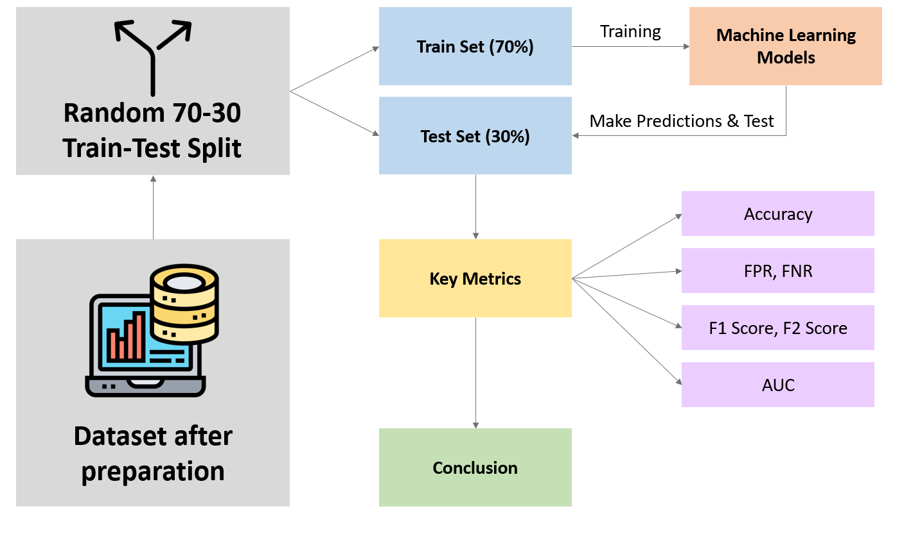
Prescriptive Techniques
Shang Yau
Question 2
What are the most significant factors to predict the accident outcome whether one dies in a road accident?

Slide 20
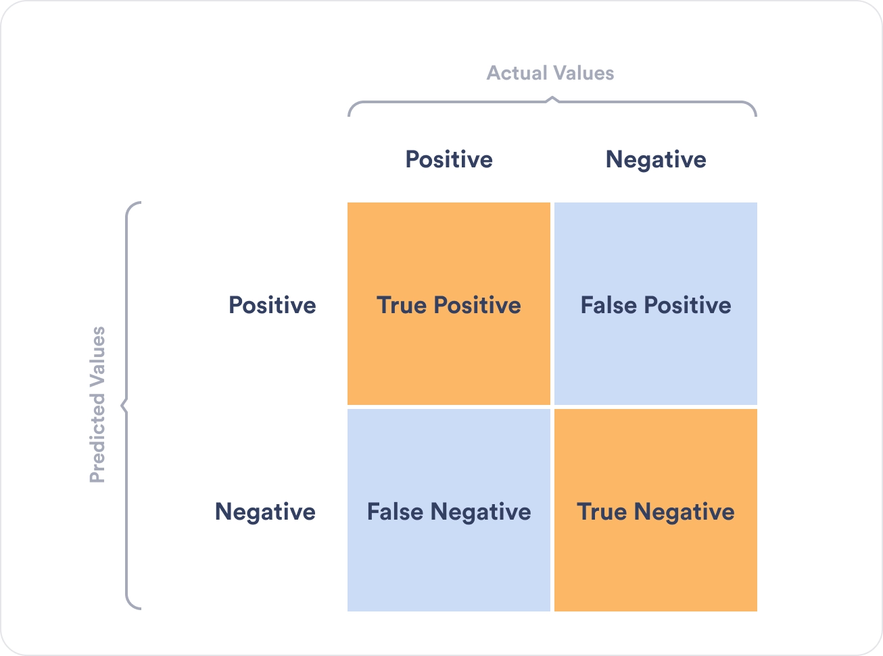
Prescriptive Techniques
Shang Yau
Confusion Matrix
True Positive (TP) = | Fatal Accidents correctly predicted as fatal
True Negative (TN) = | Non-fatal accidents correctly predicted as non-fatal
False Positive (FP) = | Non-fatal Accidents incorrectly predicted as fatal
False Negative (FN) = | Fatal Accidents incorrectly predicted as non-fatal

Slide 21

Basis of Comparisons
Shang Yau
ACCURACY
FALSE POSITIVE RATE (FPR)
FALSE NEGATIVE RATE (FNR)
Percentage of correct predictions compared to all predictions
Percentage of correct Predictions compared to all predictions
Percentage of FP compared to all non-fatal accident predictions
Percentage of NP compared to all fatal accident predictions
AREA UNDER CURVE (AUC)
F1 SCORE
F2 SCORE
Measure of classifiers’ ability to differentiate between classes.
(Higher scores = better classification)
Harmonic mean of precision and recall
Weighted harmonic mean of precision and recall, which emphasis on False Negatives

Slide 22
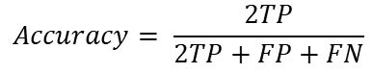
Basis of Comparisons
Shang Yau
ACCURACY
FALSE POSITIVE RATE (FPR)
FALSE NEGATIVE RATE (FNR)
$$Accuracy= \frac{2TP}{2TP+FP+FN}$$
Percentage of FP compared to all non-fatal accident predictions
Percentage of NP compared to all fatal accident predictions
AREA UNDER CURVE (AUC)
F1 SCORE
F2 SCORE
Measure of classifiers’ ability to differentiate between classes.
(Higher scores = better classification)
Harmonic mean of precision and recall
Weighted harmonic mean of precision and recall, which emphasis on False Negatives

Slide 23
Basis of Comparisons
Shang Yau
ACCURACY
FALSE POSITIVE RATE (FPR)
FALSE NEGATIVE RATE (FNR)
$$Accuracy= \frac{2TP}{2TP+FP+FN}$$
Percentage of FP compared to all non-fatal accident predictions
Percentage of NP compared to all fatal accident predictions
AREA UNDER CURVE (AUC)
F1 SCORE
F2 SCORE
Measure of classifiers’ ability to differentiate between classes.
(Higher scores = better classification)
Harmonic mean of precision and recall
Weighted harmonic mean of precision and recall, which emphasis on False Negatives

Slide 24
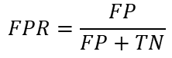
Basis of Comparisons
Shang Yau
ACCURACY
FALSE POSITIVE RATE (FPR)
FALSE NEGATIVE RATE (FNR)
$$Accuracy= \frac{2TP}{2TP+FP+FN}$$
$$FPR=\frac{FP}{FP+TN}$$
Percentage of NP compared to all fatal accident predictions
AREA UNDER CURVE (AUC)
F1 SCORE
F2 SCORE
Measure of classifiers’ ability to differentiate between classes.
(Higher scores = better classification)
Harmonic mean of precision and recall
Weighted harmonic mean of precision and recall, which emphasis on False Negatives

Slide 25
Basis of Comparisons
Shang Yau
ACCURACY
FALSE POSITIVE RATE (FPR)
FALSE NEGATIVE RATE (FNR)
$$Accuracy= \frac{2TP}{2TP+FP+FN}$$
$$FPR=\frac{FP}{FP+TN}$$
Percentage of NP compared to all fatal accident predictions
AREA UNDER CURVE (AUC)
F1 SCORE
F2 SCORE
Measure of classifiers’ ability to differentiate between classes.
(Higher scores = better classification)
Harmonic mean of precision and recall
Weighted harmonic mean of precision and recall, which emphasis on False Negatives

Slide 26
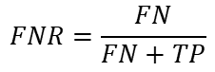
Basis of Comparisons
Shang Yau
ACCURACY
FALSE POSITIVE RATE (FPR)
FALSE NEGATIVE RATE (FNR)
$$Accuracy= \frac{2TP}{2TP+FP+FN}$$
$$FPR=\frac{FP}{FP+TN}$$
$$FNR=\frac{FN}{FN+TP}$$
AREA UNDER CURVE (AUC)
F1 SCORE
F2 SCORE
Measure of classifiers’ ability to differentiate between classes.
(Higher scores = better classification)
Harmonic mean of precision and recall
Weighted harmonic mean of precision and recall, which emphasis on False Negatives

Slide 27
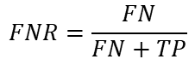
Basis of Comparisons
Shang Yau
ACCURACY
FALSE POSITIVE RATE (FPR)
FALSE NEGATIVE RATE (FNR)
$$Accuracy= \frac{2TP}{2TP+FP+FN}$$
$$FPR=\frac{FP}{FP+TN}$$
$$FNR=\frac{FN}{FN+TP}$$
AREA UNDER CURVE (AUC)
F1 SCORE
F2 SCORE
Measure of classifiers’ ability to differentiate between classes.
(Higher scores = better classification)
Harmonic mean of precision and recall
Weighted harmonic mean of precision and recall, which emphasis on False Negatives

Slide 28
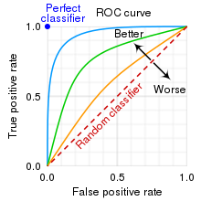
Basis of Comparisons
Shang Yau
ACCURACY
FALSE POSITIVE RATE (FPR)
FALSE NEGATIVE RATE (FNR)
$$Accuracy= \frac{2TP}{2TP+FP+FN}$$
$$FPR=\frac{FP}{FP+TN}$$
$$FNR=\frac{FN}{FN+TP}$$
AREA UNDER CURVE (AUC)
F1 SCORE
F2 SCORE
Harmonic mean of precision and recall
Weighted harmonic mean of precision and recall, which emphasis on False Negatives

Slide 29
Basis of Comparisons
Shang Yau
ACCURACY
FALSE POSITIVE RATE (FPR)
FALSE NEGATIVE RATE (FNR)
$$Accuracy= \frac{2TP}{2TP+FP+FN}$$
$$FPR=\frac{FP}{FP+TN}$$
$$FNR=\frac{FN}{FN+TP}$$
AREA UNDER CURVE (AUC)
F1 SCORE
F2 SCORE
Harmonic mean of precision and recall
Weighted harmonic mean of precision and recall, which emphasis on False Negatives

Slide 30
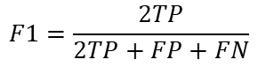
Basis of Comparisons
Shang Yau
ACCURACY
FALSE POSITIVE RATE (FPR)
FALSE NEGATIVE RATE (FNR)
$$Accuracy= \frac{2TP}{2TP+FP+FN}$$
$$FPR=\frac{FP}{FP+TN}$$
$$FNR=\frac{FN}{FN+TP}$$
AREA UNDER CURVE (AUC)
F1 SCORE
F2 SCORE
$$F1=\frac{2TP}{2TP+FP+FN}$$
Weighted harmonic mean of precision and recall, which emphasis on False Negatives

Slide 31
Basis of Comparisons
Shang Yau
ACCURACY
FALSE POSITIVE RATE (FPR)
FALSE NEGATIVE RATE (FNR)
$$Accuracy= \frac{2TP}{2TP+FP+FN}$$
$$FPR=\frac{FP}{FP+TN}$$
$$FNR=\frac{FN}{FN+TP}$$
AREA UNDER CURVE (AUC)
F1 SCORE
F2 SCORE
$$F1=\frac{2TP}{2TP+FP+FN}$$
Weighted harmonic mean of precision and recall, which emphasis on False Negatives

Slide 32
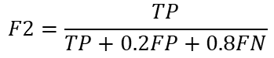
Basis of Comparisons
Shang Yau
ACCURACY
FALSE POSITIVE RATE (FPR)
FALSE NEGATIVE RATE (FNR)
$$Accuracy= \frac{2TP}{2TP+FP+FN}$$
$$FPR=\frac{FP}{FP+TN}$$
$$FNR=\frac{FN}{FN+TP}$$
AREA UNDER CURVE (AUC)
F1 SCORE
F2 SCORE
$$F1=\frac{2TP}{2TP+FP+FN}$$
$$F2=\frac{TP}{TP+0.2FP+0.8FN}$$

Slide 33
Basis of Comparisons
Shang Yau
ACCURACY
FALSE POSITIVE RATE (FPR)
FALSE NEGATIVE RATE (FNR)
$$Accuracy= \frac{2TP}{2TP+FP+FN}$$
$$FPR=\frac{FP}{FP+TN}$$
$$FNR=\frac{FN}{FN+TP}$$
AREA UNDER CURVE (AUC)
F1 SCORE
F2 SCORE
$$F1=\frac{2TP}{2TP+FP+FN}$$
$$F2=\frac{TP}{TP+0.2FP+0.8FN}$$

Slide 34

Predictive Models
Shang Yau
What is
Logistic Regression
Logistic Regression is a Classification Model
MARS
How it Works:
Using a sigmoid function, the models map the predicted values to probabilities
Output values are between 0 and 1
Based on a decided treshold level (eg. 0.5), it will classify the response value as either “above threshold” or “below threshold”
P-value > 0.5
FATAL
Traffic accident
THRESHOLD:
P-value = 0.5
Neural Network
NON-FATAL
Traffic accident
P-value < 0.5
Random Forest

Slide 35
Predictive Models
Shang Yau
What is
Logistic Regression
Logistic Regression is a Classification Model
MARS
How it Works:
Using a sigmoid function, the models map the predicted values to probabilities
Output values are between 0 and 1
Based on a decided treshold level (eg. 0.5), it will classify the response value as either “above threshold” or “below threshold”
P-value > 0.5
FATAL
Traffic accident
THRESHOLD:
P-value = 0.5
Neural Network
NON-FATAL
Traffic accident
P-value < 0.5
Random Forest

Slide 36


Predictive Models
Shang Yau
Optimising
Logistic Regression
Optimising the Logistic Regression
MARS
Full Model (With all the variables)
Backward Stepwise Elimination:
Removing the least significant variables, based on their p-values.
If,
p-value < 0.01
Variable = insignificant in predicting the outcome
Removing the least significant variable
Neural Network
Model with 4 variables left
Removing the least significant variable
Random Forest
Model with 3 variables left

Slide 37
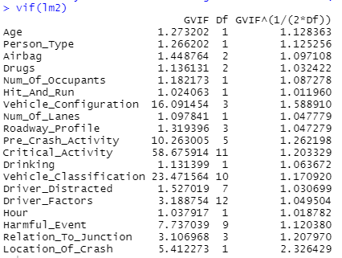
Predictive Models
Shang Yau
Optimising
Logistic Regression
Optimising the Logistic Regression
MARS
Minimising Multicollinearity:
Multicollinearity happens when there is high correlations amongst several independent variables
(-) Unreliable coefficient estimates
(-) Reduced power to detect effect of individual predicters
To Reduce Multicollinearity, we can make use of Variance Inflation Factor (VIF), which is a statistical measure used to quantify the extent of multicollinearity
If,
Generalised VIF > 10
Variable is removed from the final model
Neural Network
Random Forest

Slide 38
Predictive Models
Shang Yau
Results
Logistic Regression
Evaluation of Logistic Regression’s Performance
Metric
Logistic Regression
MARS
Accuracy
84.7%
FPR
18.5%
Neural Network
FNR
Test set Metrics:
11.4%
AUC
0.930
Random Forest
F1 Score
0.842
F2 Score
0.868

Slide 39
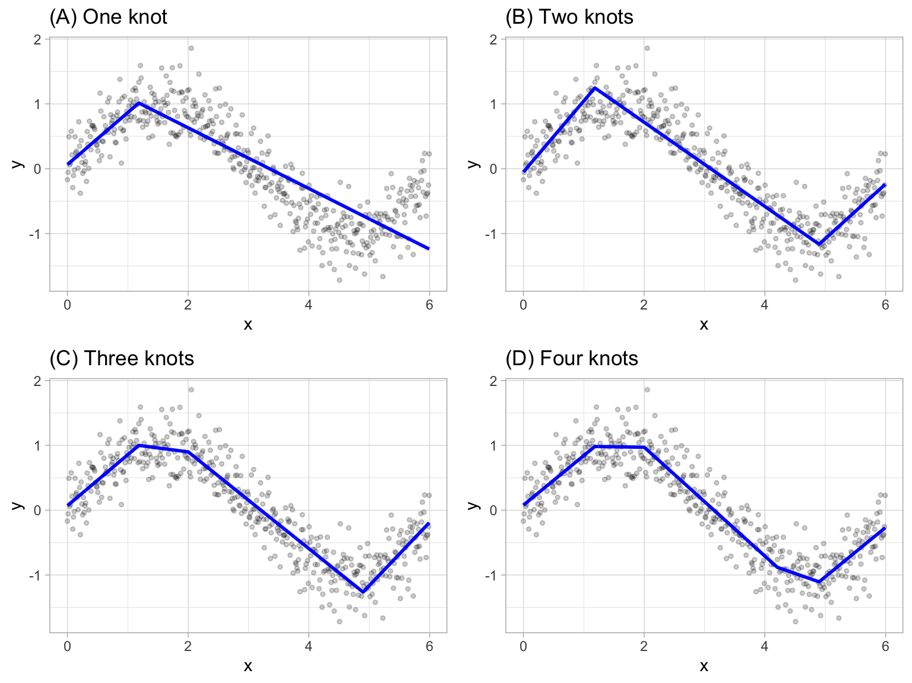
Predictive Models
Shang Yau
What is
Logistic Regression
Multivariate Adaptive Regression Splines (MARS) is a highly flexible regression model
How it Works:
Recursively partitioning the data into smaller segments/ “splines”
The position of where each change in segments happens, “knots”, are based on each predictor’s relationship with response variable
Each segment has a linear regression fitted into it
Able to identify
between various explanatory variables
MARS
Neural Network
Random Forest
non-linear interactions

Slide 40
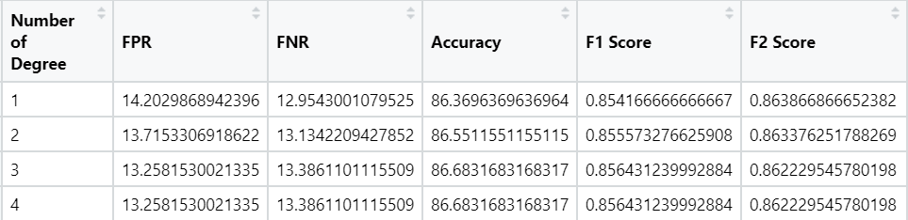
Predictive Models
Shang Yau
Optimising
Logistic Regression
Optimising MARS by varying the number of “Degrees”
non-linear interactions
Identify between various factors, and how such interaction affect the response variable
MARS
“Degrees” refer to the maximum number of features involved in each interaction.
Neural Network
Random Forest

Slide 41
Predictive Models
Shang Yau
Results
Evaluation of MARS’s Performance
Logistic Regression
Metric
MARS
Accuracy
86.4%
MARS
FPR
14.2%
FNR
Test set Metrics:
13.0%
Neural Network
AUC
0.947
F1 Score
0.854
Random Forest
F2 Score
0.864

Slide 42
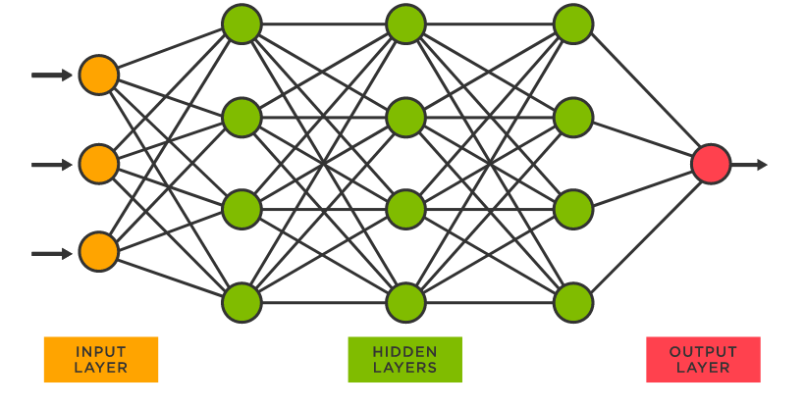
Predictive Models
Loy Sheng
Nodes
What is
Weights
Logistic Regression
MARS
Neural Network
Random Forest
Notes:
Machine Learning model that aims to simulates a human brain
Nodes are split into input, hidden and output layers
Each Individual node will have a function composing of input data, weights, bias and corresponding output
Terminal node contains a prediction for the outcome variable
Useful for modeling nonlinear and complex relationships
Weights will be adjusted during training whenever it makes a wrong predictions in a process called backpropagation

Slide 43
Predictive Models
Loy Sheng
Results
Neural Network
Logistic Regression
Metric
Train Set
Test Set
Accuracy
98.3%
83.4%
Neural Network performs significantly worse on test set data.
MARS
WHY?
FPR
12.5%
16.3%
FNR
2.0%
16.7%
Neural Network
AUC
0.983
0.832
F1 Score
0.985
0.847
Random Forest
F2 Score
0.982
0.838

Slide 44
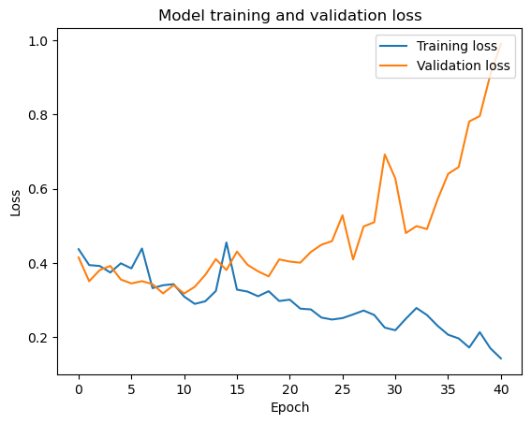
Predictive Models
Loy Sheng
Interpretation
Logistic Regression
MARS
Neural Network
Random Forest
Notes:
In particular, the model performs well on training data but poorly on the new data in the validation set. At a point, the validation loss decreases but starts to increase again.
The training data size is too small and does not contain enough data samples to accurately represent all possible input data values.
The model is too complex.
Early Stopping of training was initiated at 40 epochs
Clear indication of overfitting from both graphs

Slide 45
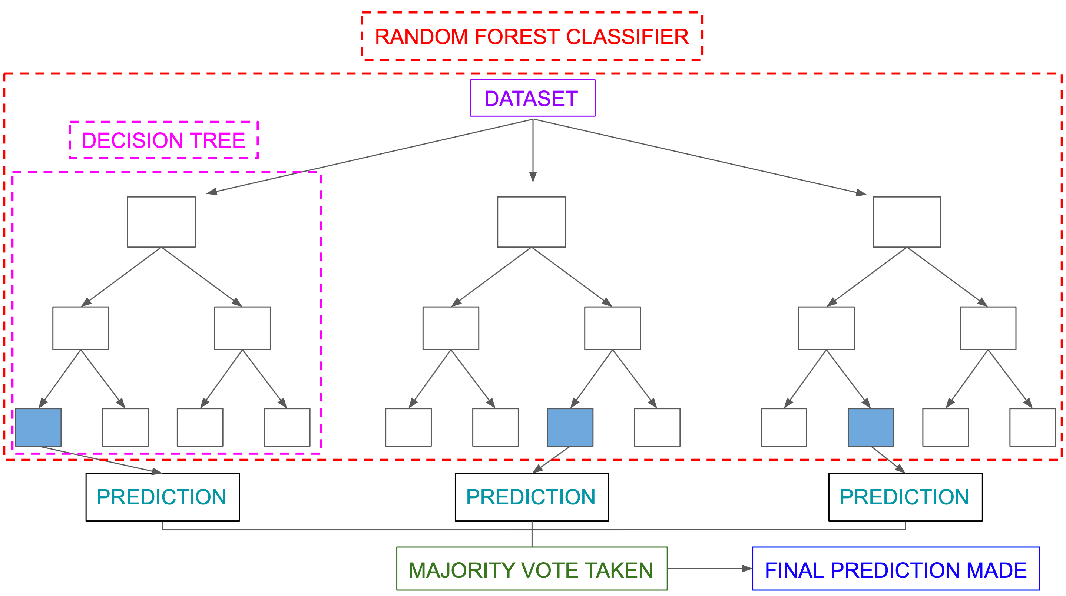
Predictive Models
Loy Sheng
What is
Random Forest is a Machine Learning model that combines
Logistic Regression
MARS
Bootstrap
Random Subset Feature
Neural Network
Random Forest
Aggregation
Notes:
There are 3 features that make up a RF model.
Bootstrap,RSF,Aggregation
RF is essentially a machine learning model that comprises of many smaller different models.

Slide 46
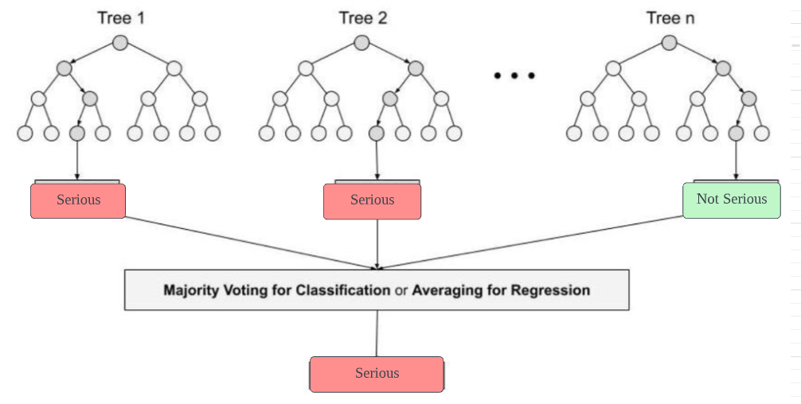
Predictive Models
Loy Sheng
What is
Aggregation
Logistic Regression
MARS
Death
Death
No Death
Neural Network
Random Forest
Death
Notes:
Introduction to Random Forest in Machine Learning | Engineering Education (EngEd) Program | Section\
Random Forest is not as prone to overfitting as the other models shown above. This is due to the combination of Bootstrapping, RSF which creates new decision trees based of a different sample of the original data and does each split with a random set of X variables. The trees are also grown to the max to infuse additional controlled instability. Eventually as many different trees are created, their results are all aggregated to give a more accurate output from a singular input.
Trees are grown the to max.
Each model ‘s outputs will be aggregated
Majority vote will be taken

Slide 47
Predictive Models
Loy Sheng
Results
Logistic Regression
Metric
Random Forest
Accuracy
86.8%
MARS
Random Forest performed well.
In part due to the bootstrap, RSF and aggregation reducing trainset overfitting.
Extremely low score of 7.37 for false negative rate.
FPR
18.2%
FNR
Test set Metrics:
7.34%
Neural Network
AUC
0.954
F1 Score
0.865
Random Forest
F2 Score
0.901
Notes:
This means that the model correctly classifies a serious accident 92% of the time.

Slide 48
Predictive Models
Loy Sheng
Comparison
Models
Logistic Regression
Metric
Logistic Regression
MARS
Neural Network
Random Forest
Accuracy
84.7%
86.4%
83.4%
86.8%
MARS
FPR
18.5%
14.2%
16.3%
18.2%
FNR
11.4%
13.0%
16.7%
7.34%
Neural Network
AUC
0.930
0.947
0.832
0.954
F1 Score
0.842
0.854
0.847
0.865
Random Forest
F2 Score
0.868
0.864
0.838
0.901
Notes:
Introduction to Random Forest in Machine Learning | Engineering Education (EngEd) Program | Section

Slide 49
Predictive Models
Loy Sheng
Minimised Dataset
Random Forest
Logistic Regression
Metric
Original Dataset
Minimal Dataset
Accuracy
86.8%
85.0%
MARS
FPR
18.2%
13.2%
FNR
7.34%
17.1%
Neural Network
AUC
0.954
0.931
F1 Score
0.865
0.836
Random Forest
F2 Score
0.901
0.832
Notes:
F2 score gives more weightage to recall which is basically how good the model is at identifying positive cases. (death =1 )
Recall = the positive observations (true positives) the mode
Significantly worse performance on FNR
This translates to the decrease in F2 score as well
l correctly identified from all the actual positive cases (the true positives + the false negatives)
Significantly worse performance on FNR
This translates to the decrease in F2 score as well
.
Significantly worse performance on FNR. This translates to the decrease in F2 score as well

Slide 50







Factor Analysis – Key Predictors
Loy Sheng
We identified 6 Key Predictors by choosing those that ranked in the top 6 of variable importance in at least 3 out of 4 models.
Restraint System
Number Of Occupants
Hit and Run
Driver Factor
Age
Harmful Event
Notes:
Occupants who did not use any form of restraint system have a higher likelihood of dying in an accident. Specifically, seat belts prevent drivers and passengers from being ejected in case of a collision, lowering the risk of mortality rate and serious injury by 45% and 50%, respectively​
Number of occupants : More occupants = lesser death due to larger vehicle​, cyclist = less occupants.
Hit and Run : Victims often do not get medical attention in time = more deaths​
Driver Factor ( Violence ) : Violence subcategory ranks as most important predictor within driver factors. This category indicates if the driver has previously commited a violent crime. ​
Age : Younger individuals were more involved in fatal accidents than older ones. ​ Older people more likely to die if involved in accidents(under harmful event).
First Harmful event: this predictor denotes the first instance of injury and what we found out was that pedestrains, cyclists and motorcyclists are the most vulnerable to serious injuries when an accident happens.​
Restraint
Num
Harmful
Hit and run
Age
Driver factors

Slide 51

Recommendations
Yi Cheng
4 different recommendations are proposed based on the key predictors. The first recommendation is to encourage the use of restraint system.
Singapore’s Context
Recommendation
In 1993, the Government has made wearing rear seat belts mandatory.
However, there is still an increase in the number of seat-belt violations, with over 60% of back-seat passengers not wearing them.
Launch nationwide road safety campaign to educate and encourage the wearing of rear seat belts.
Partner with automakers to integrate extra safety measures such as extending the beeping sound to remind everyone to buckle up.

Slide 52

Recommendations
Yi Cheng
The second recommendation is to minimize the number of hit-and-run instances.
Singapore’s Context
Recommendation
Penalties for at-fault drivers include a ban from possessing or acquiring a driver’s licence for up to 12 months.
Despite these penalties, still many occurrences of such accidents, e.g., Pasir Ris involving elderly.
Enforce harsher penalties, such as revocation of driving licence and denial of driving privileges to offenders.
Deploy more surveillance cameras to monitor traffic and detect hit-and-run drivers.

Slide 53


Recommendations
Yi Cheng
The third recommendation is to minimize and mitigate negative driver related factors.
Singapore’s Context
Recommendation
Drivers convicted of non-traffic violence chargers may face licence suspension or disqualification if the offence is deemed to be related to their driving conduct.
Restrict driving hours to non-peak hours.
Install an ignition interlock device that requires passing a breathalyser test before the vehicle can start.
Enforce mandatory counselling session.
Notes:
Most of the violent crimes are committed by drunkards. Therefore, the use of breathalyser test.

Slide 54


Recommendations
Yi Cheng
The fourth recommendation is to minimize the number of traffic accident fatalities experienced by vulnerable road users.
Singapore’s Context
Recommendation
Singapore’s ratio of fatal pedestrians per 100k people was 0.4 in 2021.
There is also an increase in elderly pedestrian fatalities.
Partner with automakers to integrate blind spot radar system and traffic sensing device.
This is to provide the driver with a comprehensive view of the car’s surroundings.

Slide 55
Limitations
Yi Cheng
Data Limitations
Model Limitations
Models are trained on US traffic data.
Therefore, distinctive traffic characteristics that is unique to Singapore’s context may not be considered. This thus reduces the use case and effectiveness of the results produced.
The proposed model, Random Forest, is a black-box model.
The lack of interpretability; model’s decision process is not transparent and explainable, making it hard to make informed decisions.
Inevitable Room for Growth
Despite these limitations, the potential of utilising machine learning to prevent fatal traffic accidents in Singapore still remains.

Slide 56



Future Work
Yi Cheng
Interactive Dashboard
Location Analytics
Automated Retraining
Allows LTA staff to intuitively interact with the data, perform what-if analysis, and assess effectiveness of the various measures.
Allows LTA to identify high-risk areas, allocate resources effectively, and prioritise infrastructure improvements.
Use of MLOps pipelines to perform continuous training and delivery of model prediction; iterative process.
Notes:
Future developments should be considered to further maximize the potential of machine learning and develop a strong use case.
Automated Retraining: The goal of level 1 is to perform continuous training of the model by automating the ML pipeline; this lets you achieve continuous delivery of model prediction service. To automate the process of using new data to retrain models in production, you need to introduce automated data and model validation steps to the pipeline, as well as pipeline triggers and metadata management.

Slide 57

THANK YOU.
Yi Cheng

Slide 58
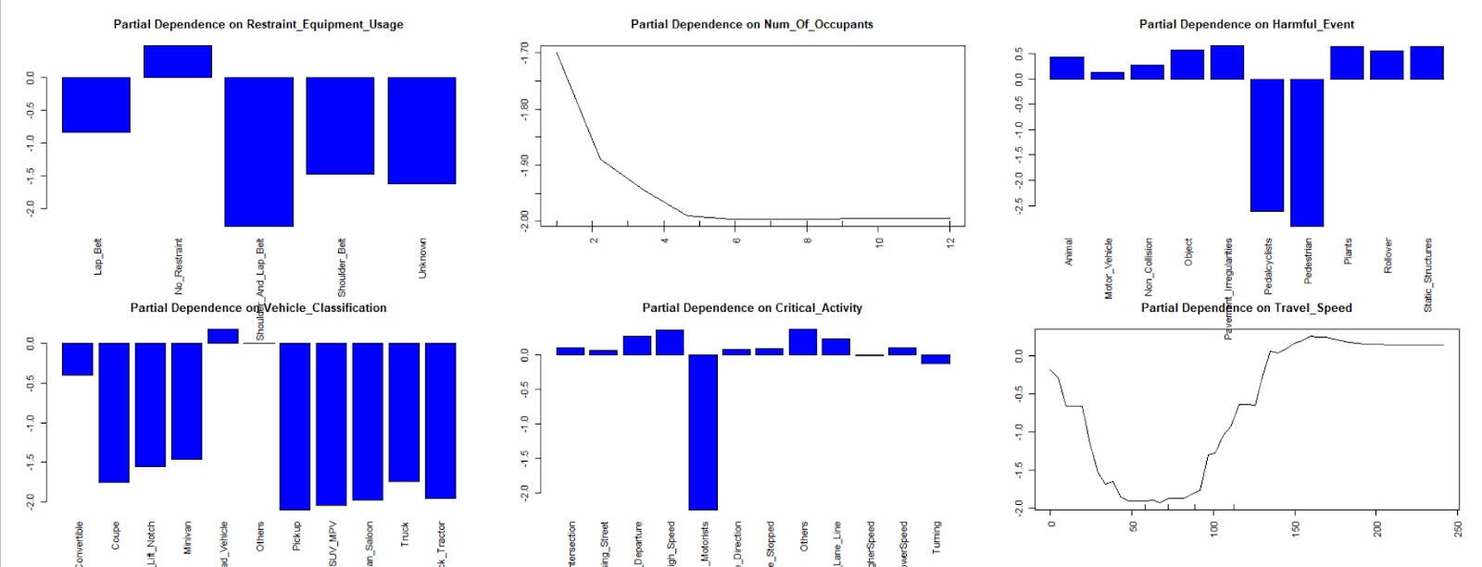
Appendix – Predictive Models
Loy Sheng
Interpretation
Logistic Regression
MARS
Neural Network
Study of Partial Dependence Plots
Random Forest
Restraint equipment usage, no restraint led to higher death rate
Travel Speed over 100 greatly increases chance of Death
Notes:
Introduction to Random Forest in Machine Learning | Engineering Education (EngEd) Program | Section

Slide 59
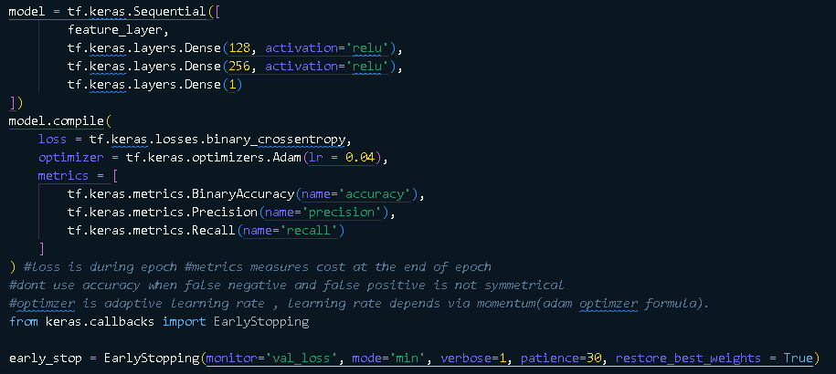
Predictive Models
Loy Sheng
Model
Model trained and validated for 100 epochs and Batch size of 16
Neural Network was built with 2 hidden layers.
Early Stopping with minimizing val_loss as the goal
Logistic Regression
MARS
Neural Network
Random Forest
Notes:
In other words, the model runs through the entire dataset a total of 100 iterations and processes 16 samples before the model’s parameters are updated during training

Slide 60
Predictive Models
Loy Sheng
What is
At each split, only some X variables will be considered.
This is to diminish the effects of a dominant X's in prediction.
Infuse Controlled Instability for better performance
Logistic Regression
Random Subset Feature
MARS
Neural Network
Random Forest
Notes:
Introduction to Random Forest in Machine Learning | Engineering Education (EngEd) Program | Section
• How to improve Bagging results? • How to infuse controlled instability, even in the presence of dominant X?
. • Controlled Instability: Maintain accuracy while increasing diversity of models.
1. Random Subset Feature Selection (Different subset of Xs, randomly at each split), and at the same time,
2. Grow the CART tree to the max from each bootstrap sample to maintain high accuracy (no pruning). The bigger the tree, the higher the accuracy on trainset.

Slide 61
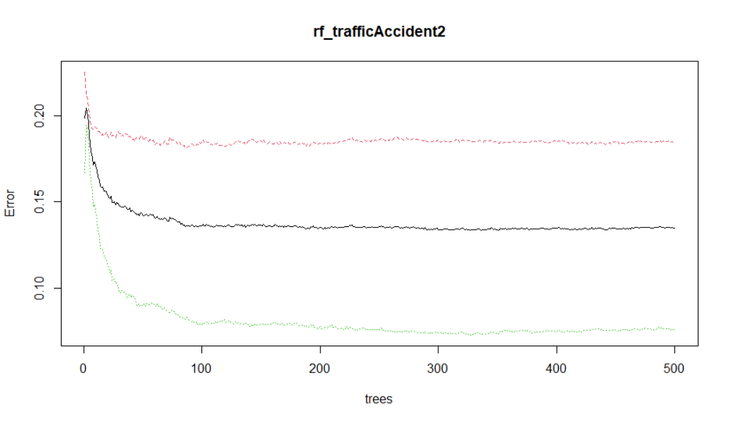
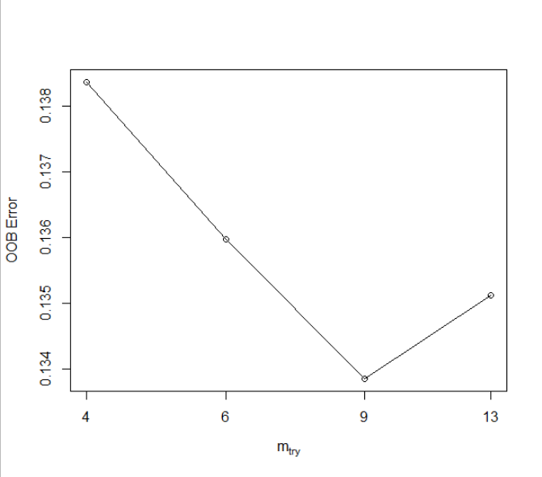
Predictive Models
Loy Sheng
Model Parameter
Model Parameters | Random Forest
mtry(RSF) | 9
ntrees | 500
Logistic Regression
MARS
Neural Network
Random Forest
Notes:
Introduction to Random Forest in Machine Learning | Engineering Education (EngEd) Program | Section\
Random Forest is not as prone to overfitting as the other models shown above. This is due to the combination of Bootstrapping, RSF which creates new decision trees based of a different sample of the original data and does each split with a random set of X variables. The trees are also grown to the max to infuse additional controlled instability. Eventually as many different trees are created, their results are all aggregated to give a more accurate output from a singular input.
Black line – overall error (100% - accuracy)
Red – false positive rate
Green – false negative rate
9 random features was used at each split
500 decision trees was built on 500 bootstrapped sample
Decision tree grown to the max

Slide 62
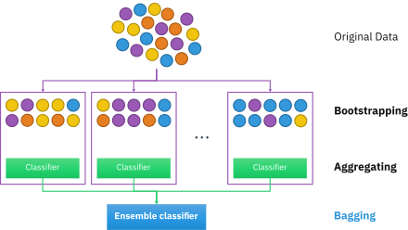
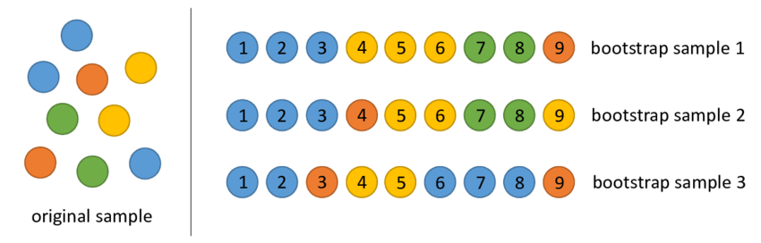
Predictive Models
Loy Sheng
What is
Bootstrap
Logistic Regression
Each Decision Tree is build using a different subset of data from original dataset.
Data points are selected with replacement from original dataset up to size of original dataset
MARS
Neural Network
Random Forest
Notes:
Introduction to Random Forest in Machine Learning | Engineering Education (EngEd) Program | Section
RF is comprised of many decision trees that are bu

